Slide 1


Slide 01
What is Agent Memory?
Storing Context to Power Autonomous Workflows
DEFINITION
REAL-LIFE ANALOGY
Agent Memory is the core mechanism enabling LLMs to retain conversational history (Short-term) and retrieve external knowledge (Long-term) to inform strategic Planning and execute Tools with precision.
Whiteboard: Short-term memory (current active task state).
Filing Cabinet: Long-term memory (historical project archives).
Mapping: By structuring storage, agents reference previous actions to continuously optimize execution.
Retention
Retrieval
Context
FLOW EXAMPLE
CODE EXAMPLE
Input
→
Query DB
→
Retrieve Fact
→
Execute Tool
→
Out
MEMORY INIT
TOOL USAGE
import memory agent_mem = memory.init() agent_mem.add("user_pref")
context = agent_mem.get() tool.execute(query, context)
This architecture allows the system to gather relevant context dynamically before executing critical agent logic.
Memory transforms an AI from a stateless responder into a continuous collaborator.
Combining recalled knowledge with actionable tool use.

Slide 2

Slide 02
Foundation of Context
Understanding how AI systems remember state.
Without a memory architecture, every interaction is a blank slate.

Slide 3





Slide 03
The Memory Hierarchy
Short-Term Memory
Long-Term Memory
Stores the immediate conversational history. Typically held in RAM and passed into the prompt context.
Vast historical data stored persistently. Uses Vector Databases to recall relevant facts across sessions.
Working Memory
Episodic Memory
Temporary scratchpad used during active reasoning (e.g., holding a variable during tool execution).
Storing specific past experiences ("episodes") of successful or failed tasks to improve future planning.
Like human cognition, agents require multiple tiers of memory for optimal performance.

Slide 4


Slide 04
Short-term vs. Long-term
Short-term (In-Context)
Long-term (Vector Store)
Relies on maintaining a list of recent messages. Limited strictly by the LLM's context window (e.g., 128k tokens).
Relies on embedding text into high-dimensional vectors and storing them on disk. Unlimited capacity.
Perfect for maintaining the flow of a single, active conversation. Erased when the session ends.
Perfect for storing company knowledge bases or user preferences permanently across months of usage.
Use short-term for chat fluidity, and long-term for permanent knowledge retention.

Slide 5









Slide 05
Vector Database Flow
1. Chunk
2. Embed
3. Store
4. Retrieve
Split massive documents into small text chunks.
Convert text chunks into numerical vectors.
Save vectors in a database (e.g., Pinecone).
Search via mathematical similarity.
Vector databases allow agents to search meaning and concepts, not just exact keywords.

Slide 6
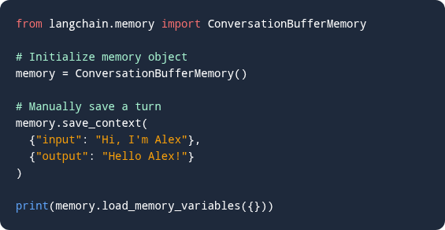
Slide 06
Message History Code
Implementing a basic Short-Term memory buffer.
Python (LangChain)
How it Works
The ConversationBufferMemory simply stores inputs and outputs in a list. When the LLM is called again, this entire list is injected into the prompt.
Memory libraries abstract away the complexity of string manipulation for chat histories.

Slide 7





Slide 07
Types of Retrieval
Semantic Search
Recency Bias
Hybrid Search
Retrieving documents based on mathematical closeness in vector space.
Prioritizing memories or data that were added most recently.
Combining vector similarity with traditional keyword exact-matching.
Hybrid search provides the most robust retrieval architecture for production agents.

Slide 8


Slide 08
Vector Embeddings
Embeddings are the secret behind long-term memory. They turn words into coordinates in a multidimensional space.
Proximity
Words with similar meanings cluster together (e.g., "Dog" and "Puppy").
Search
When a user asks a question, it is embedded, and the DB finds the closest coordinates.
Result
The agent is fed the exact document containing the answer.
Embeddings translate human language into a format computers can organize by concept.

Slide 9
Slide 09
Storage Trade-offs
Choosing the right database for long-term memory.
Solution Type | Example | Best Use Case
In-Memory Local | FAISS, ChromaDB | Prototyping, small document sets, local testing.
Managed Cloud DB | Pinecone, Weaviate | Production scale, millions of vectors, zero maintenance.
Traditional + Vector | PostgreSQL (pgvector) | Enterprise apps keeping relational and vector data together.
Start with local ChromaDB for testing, and migrate to managed Cloud DBs for scale.

Slide 10

Slide 10
Tool Calling Deep Dive
Empowering agents to interact with external systems.
Tools bridge the gap between static knowledge and dynamic execution.

Slide 11





Slide 11
Anatomy of a Tool Call
Name
Description
Parameters
Return Type
Unique identifier for the function (e.g., `get_weather`).
Crucial text telling the LLM exactly when to use it.
JSON schema defining required inputs (e.g., `location`).
Format of the data sent back to the LLM observation.
The LLM never runs the code; it generates a JSON object matching your Tool Schema.

Slide 12
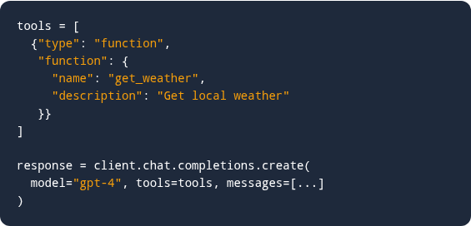
Slide 12
Tool Calling Syntax
Binding tools to an LLM instance.
visibility
Tool Awareness
By passing the tools array to the API, the LLM becomes fully aware of all available external capabilities.
code
Structured Output
If the model decides to invoke a tool, it halts standard text generation and returns a structured tool_calls JSON object.
Modern LLMs are fine-tuned to recognize tool schemas and output valid JSON arguments.

Slide 13
Slide 13
Tool Execution Lifecycle
Model Decision
App Interception
The LLM decides a tool is needed and outputs JSON parameters.
Your application code intercepts the JSON and halts the LLM generation.
Local Execution
Return Observation
Your app runs the actual Python function or API call using the provided parameters.
Your app feeds the raw output back to the LLM so it can continue reasoning.
The application code acts as the middleman between the LLM brain and the target system.

Slide 14



Slide 14
Common Tool Categories
Web Search
Math Engines
RAG Retrieval
Tavily or DuckDuckGo wrappers to bypass knowledge cutoff dates.
Python REPL or calculators to prevent arithmetic hallucinations.
Tools linked to internal vector databases for corporate knowledge.
Supply only the specific tools required for the task to avoid confusing the agent.

Slide 15
Slide 15
Passing Arguments
The most common point of failure in tool calling is incorrect argument passing.
01
02
03
Data Typing
Descriptions Help
Validation
If an API expects an integer, the LLM must not send a string.
Be explicit in descriptions: "Pass dates strictly in YYYY-MM-DD format."
Always use Pydantic models (in Python) to validate arguments before execution.
Strict schema validation protects your external APIs from bad inputs generated by LLMs.

Slide 16
Slide 16
Static vs Dynamic Tools
Static Tools
Dynamic Execution
Pre-compiled tools hardcoded into the agent logic (e.g., a specific Calculator tool).
Allowing the agent to write arbitrary Python code and execute it on the fly.
Safe, predictable, and easy to secure. Recommended for production enterprise environments.
Extremely powerful but highly dangerous without strict sandboxing and containerization.
Default to static APIs. Only use dynamic execution for advanced data analysis workflows.

Slide 17

Slide 17
Feedback & Planning
Orchestrating autonomous logic flows.
Agents reach their goals by constantly evaluating their current state.

Slide 18
Slide 18
The Feedback Loop
Act
Observe
The agent executes a tool (e.g., query database for "Account 123").
The tool returns an observation (e.g., "Error: Account not found").
Analyze
Adjust
The LLM analyzes the error. Realizes "123" might be wrong format.
LLM formulates a new plan and tries querying with "ACCT-123".
Feedback loops allow agents to recover gracefully from unforeseen errors.

Slide 19




Slide 19
Planning Strategies
Linear Chain
ReAct
Plan-and-Solve
Tree of Thoughts
Step A always triggers Step B. No decision making.
Think -> Act -> Observe loop. High adaptability.
Create full task list upfront, then execute sequentially.
Exploring multiple paths simultaneously and voting.
Choose Plan-and-Solve for predictable tasks, ReAct for exploration.

Slide 20
Slide 20
System Prompt Setup
Engineering the prompt to force self-correction.
system_prompt.py
Critical Failure Handling
Explicit instructions in the system prompt are critical. Without them, the LLM might panic on a tool error and immediately apologize to the user instead of retrying.
system_prompt = """
Evaluate your previous action.
If the tool returned an error:
1. Analyze the failure reason.
2. Adjust your parameters.
3. Try calling the tool again.
If successful, proceed to synthesize
the final answer for the user.
"""
play_arrowPro Tip: Treat prompts as operational manuals.
Always instruct the agent on how to handle failure states explicitly.

Slide 21



Slide 21
Common Failure Modes
Hallucination
Infinite Loops
Parsing Errors
Agent claims to have used a tool but actually just generated fake output.
Agent gets stuck calling the same broken API with the same bad parameters.
LLM fails to format the JSON correctly, breaking the app execution logic.
Agents are brittle. Engineering effort must focus on handling these edge cases.

Slide 22
Slide 22
Recovery Strategies
How to handle agent breakdowns.
Failure Mode | Standard App Response | Agentic Recovery Strategy
JSON Parse Error | Throw 500 Server Error | Catch error, feed error string back to LLM to self-correct syntax.
Infinite Loop | Crash application | Implement max_iterations counter; force fallback output.
Missing Data | Return Null | Agent prompts user: "Could you provide your account number?"
Feed exceptions back into the LLM prompt; it is surprisingly good at fixing its own code.

Slide 23

Slide 23
Case Study: Support Agent
Combining Memory and Tools in Customer Support.
Customer service is the prime testing ground for memory-augmented agents.

Slide 24





Slide 24
Support Architecture
Short-term
Long-term
RAG Tool
Action Tool
Tracks the current issue (e.g., "Resetting router").
Stores customer device history and past ticket resolutions.
Queries corporate knowledge base for troubleshooting steps.
API to issue refunds or trigger physical router restarts.
A modern support bot requires integration across four distinct modules.

Slide 25
Slide 25
Step-by-Step Resolution
Identify User
Analyze Issue
Agent checks Long-Term memory vector DB to see user's active subscriptions.
Reads current chat (Short-Term). User says "Internet is down again."
Consult Manual
Take Action
Agent uses RAG Tool to pull the exact reset procedure for the user's specific router model.
Agent triggers the API Tool to run a remote diagnostic test and informs the user.
The agent synthesizes past data, current context, external knowledge, and action seamlessly.

Slide 26
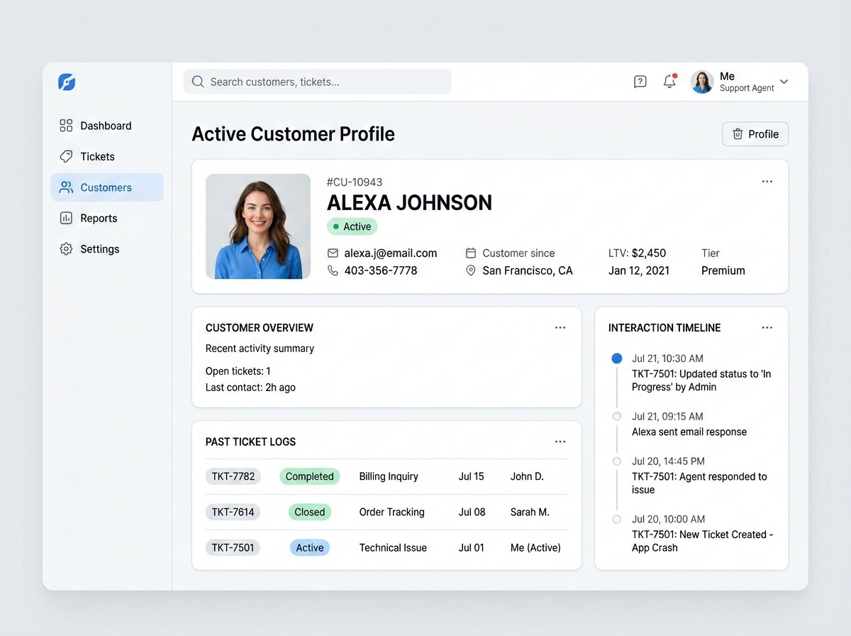
Slide 26
Accessing User History
Instead of forcing the user to repeat their issue, the agent instantly retrieves their CRM history.
🔍 Vector Database Query
search(user_id="U882", topic="past_tickets")
💡 Real-time Agent Context
"I see you called yesterday about the billing error. I have processed the $15 refund."
🚀 Strategic Impact
This drastically reduces handle time, eliminates onboarding friction, and improves overall customer satisfaction.
Contextual continuity is the hallmark of premium customer service.

Slide 27
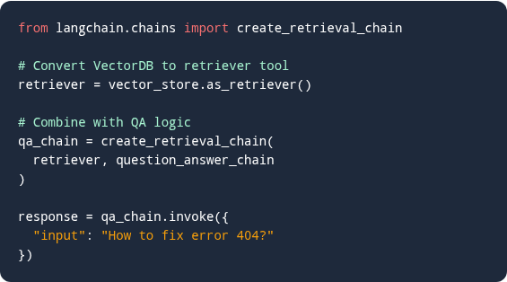
Slide 27
RAG Knowledge Base Code
Connecting the support agent to company manuals.
How the Retrieval Chain Works
Embeds: Automatically converts the user's query into a vector representation.
Searches: Queries the vector database to locate matching company manuals.
Extracts: Pulls the most relevant sections and instructional pages.
Feeds: Sends the context to the LLM to generate an accurate, plain-English response.
RAG (Retrieval-Augmented Generation) prevents the agent from guessing technical solutions.

Slide 28
Slide 28
Stateless vs Stateful
Stateless Chatbot
Stateful Agent
User: "My device is broken."
User: "My device is broken."
Bot: "What is your device type?"
Agent (Checks Memory): "I see you have the Router X2. Are the lights blinking red like last time?"
User: "I told you yesterday!"
User: "Yes exactly."
Bot: "I'm sorry, I don't have access to past chats. What is your device type?"
Agent: "Executing remote restart protocol now."
Stateful agents reduce user frustration by eliminating repetitive onboarding questions.

Slide 29



Persistent Agents
Persistent personal agents remember you across sessions. By storing vector data tied to your ID, the agent retrieves past context instantly. This enables deeply personalized workflows, completely changing how we interact with software over time. No more starting from scratch.
Memory moves AI from generic utilities to bespoke digital partners.

